Slide 1

IBM Website:
Identifying the Grain Data Warehouses
The slides in this presentation have been adapted from IBM website: https://www.ibm.com/support/knowledgecenter/SS9UM9_9.1.0/
com.ibm.datatools.dimensional.ui.doc/topics/c_dm_design_cycle_2_idgrain.html#c_dm_design_cycle_2_idgrain__c_dm_dc_2_step1

Slide 2
Learning Objectives
Describe the concept of Grain in DW tables
Identify the appropriate grain for DW tables
Explain how the atomic level of the grain determines how the higher level dimensions can be aggregated using the grain
© Copyright IBM Corporation 1994, 2017.
2

Slide 3
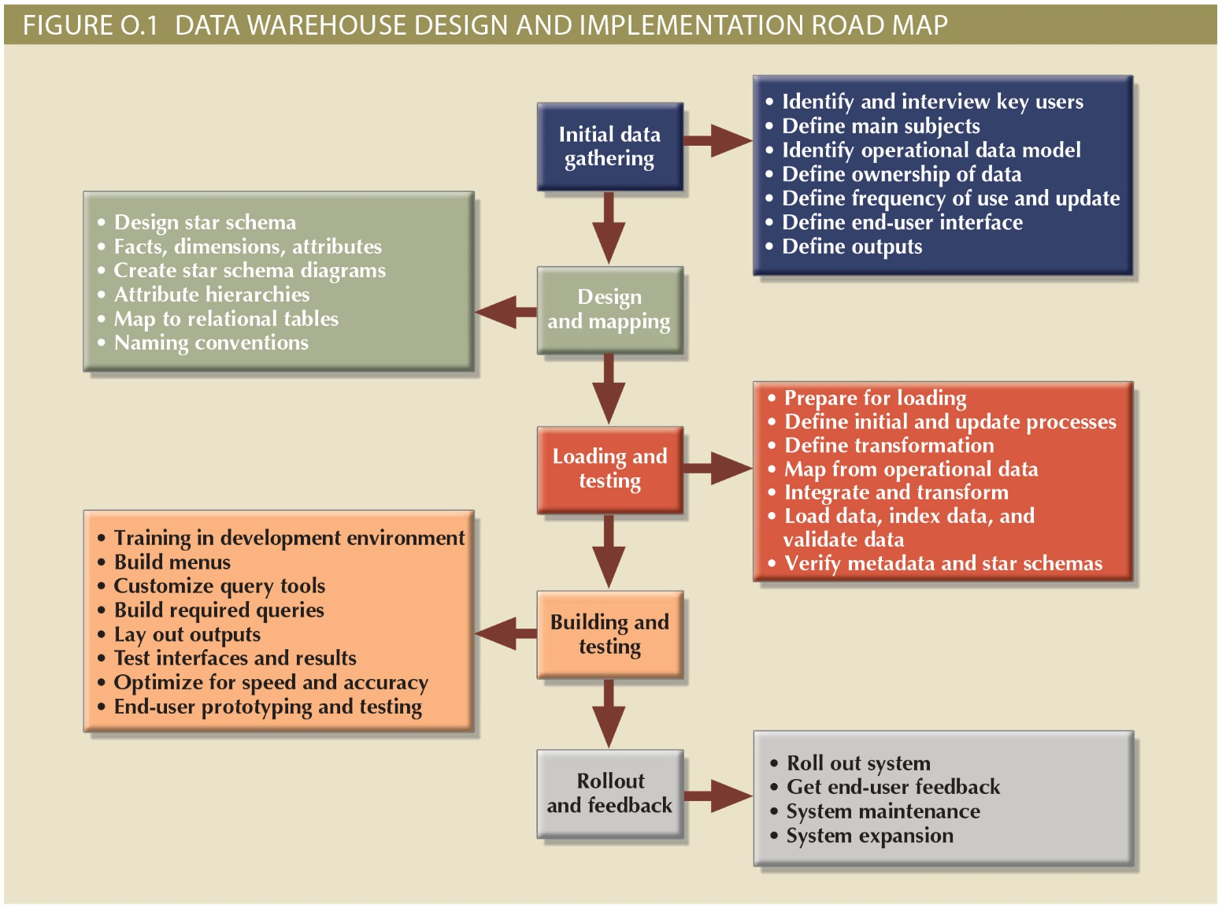
© Copyright IBM Corporation 1994, 2017.
3

Slide 4
Specifying what the records contain
When you identify the grain, you specify exactly what a fact table record contains.
The grain conveys the level of detail that is associated with the fact table measurements.
When you identify the grain, you also decide on the level of detail you want to make available in the dimensional model.
If more detail is included, the level of granularity is lower. If less detail is included, the level of granularity is higher.
© Copyright IBM Corporation 1994, 2017.
4
© Copyright IBM Corporation 1994, 2017.

Slide 5
Identifying the level of detail
The level of detail that is available in a star schema is known as the grain.
Each fact and dimension table has its own grain or granularity. Each table (either fact or dimension) contains some level of detail that is associated with it.
The grain of the dimensional model is the finest level of detail that is implied when the fact and dimension tables are joined.
For example, the granularity of a dimensional model that consists of the dimensions Date, Store, and Product is product sold in store by day.
© Copyright IBM Corporation 1994, 2017.
5

Slide 6
Identifying the data
Each row holds the same type of data.
For example, each row could contain daily sales by store by product or daily line items by store.
For example, grain definitions can include the following items:
A line item on a grocery receipt
A monthly snapshot of a bank account statement
A single airline ticket purchased on a day
© Copyright IBM Corporation 1994, 2017.
6

Slide 7
Grain Identifying Process
Determine the granularity of the fact table.
Determine how to handle multiple separate grains.
Determine the type of fact table to use.
Check the atomicity of your grains.
Determine the high-level dimensions and measures based on your grain definitions.
Create a report of your grain definitions.
© Copyright IBM Corporation 1994, 2017.
7

Slide 8
Determining the granularity of the fact table
During the business requirements gathering phase, try to collect any documents, such as invoice forms, order forms, and sales receipts. Typically, these documents have transactional data associated with them, such as order number and invoice number.
Documents can often point you to the important elements of the business, such as customer and the products. The documents often contain information at the lowest level that may be required by the business.
Another important point to consider is the date. Understand what level of detail is associated with a customer, product, or supplier. Is the information in the source systems available at the day, month, or year level?
© Copyright IBM Corporation 1994, 2017.
8

Slide 9
Handling multiple separate grains
Determine if more than one grain definition is associated with a single business process. In these cases, design separate fact tables with separate grains. Do not force all measures into a single fact table.
Different data granularities can be handled by using multiple fact tables (daily, monthly, and yearly tables, for example). Also, consider the amount of data, space, and the performance requirements when you decide how to handle multiple granularities.
© Copyright IBM Corporation 1994, 2017.
9

Slide 10
Criteria for one or multiple fact tables
Consider the measures. Decide whether to group the measures in one fact table or separate in fact tables with different grains.
Are multiple OLTP source systems involved? If you must keep the systems separate, each source system caters to a particular requirement of the business. If the business processes include order management, store inventory, or warehouse inventory, separate source systems are probably involved. In most cases, use separate fact tables.
Determine if multiple, unrelated business processes are involved. Create separate fact tables for unrelated business processes.
If a single business process requires different levels of granularity, create separate fact tables to handle those levels.
If a dimension is not true to the grain definition, design a new fact table with its own grain definition.
© Copyright IBM Corporation 1994, 2017.
10

Slide 11
Criteria for one or multiple fact tables
Consider the timing and sequencing of events. You might need separate processes to handle a single event. For example, a company markets its product. Customers order the products. The accounts receivable department produces an invoice. The customer pays the invoice. After the purchase, the customer may return some of the products or send some of the products back for repairs. If any of the products are out of warranty, this process requires new charges. Several processes are involved in the sequence of single purchase event. Each of these processes are likely working with a particular different point in time. Each of these processes are handled using separate fact tables.
© Copyright IBM Corporation 1994, 2017.
11

Slide 12
Multiple granularities in a single fact table
If you use multiple grains in one fact table, add a column called the granularity flag.
This column would indicate the grain of the row in the table.
The column defines whether the information is stored at the daily, weekly, monthly, or yearly level.
© Copyright IBM Corporation 1994, 2017.
12

Slide 13
Checking the atomicity of the grain
Review the atomicity (level of detail) of the grain to make sure that it is at the most detailed level. This decision includes consideration for anticipated future needs in order to minimize the potential for a required redesign as business requirements change.
Even if the business requirements need information at the monthly or quarterly level, make this information available at the daily level. If dimensions are more detailed (atomic), the business can retrieve more detailed information.
For example, consider a Date dimension that has only a Year attribute. Since there is only one attribute, you cannot query for information at the quarter, month, or day level. To maximize available information, choose a detailed atomic grain. In this example, you can define the grain to the Day level.
© Copyright IBM Corporation 1994, 2017.
13

Slide 14
Checking the atomicity of the grain
For example, assume a grain of one product sold in a store. You cannot associate a customer with a particular product that is purchased, because there is only one row for a product. If the product is purchased a thousand times by a thousand different customers, you cannot discover that information.
You can always declare higher-level grains for a business process by using aggregations of the most atomic and detailed data. However, when a higher-level grain is selected, the number of dimensions are limited and may be less granular. You cannot drill down into these less granular dimensions to get a lower level of detail.
© Copyright IBM Corporation 1994, 2017.
14

Slide 15
Granularity allows trade-off between important issues
The performance versus the volume of data (and the related cost of storing that data)
Selecting the appropriate level of granularity significantly affects the volume of data in the data warehouse.
The ability to access data at a detailed level versus performance (and the cost of storing and accessing large volumes of data)
The level of granularity also determines the capability of the data warehouse to satisfy query requirements.
© Copyright IBM Corporation 1994, 2017.
15

Slide 16
Identify high-level dimensions and measures
Identify high-level preliminary dimensions and measures from what you understand of the grain definition. No detailed analysis is carried out to identify these preliminary dimensions and measures.
Preliminary measures are measures that can be easily identified by looking at the grain definition. For example, measures such as unit price, quantity, and discount are easily identifiable by looking at the grain.
© Copyright IBM Corporation 1994, 2017.
16

Slide 17
Summary
Grain is the lowest level of detail in the fact table
All higher dimension data are aggregations of the grain
Multiple facts usually mean multiple fact tables
It is possible to store multiple facts in the same table, but almost never the right design
Grain is related to performance
Not detailed enough to meet requirements, i.e., answer management’s questions
Lowest level of detail grains require more data storage and processing for queries
© Copyright IBM Corporation 1994, 2017.
17

Slide 18
Task
Find an example of an DW fact table in the textbook. Determine the grain of the table you find.
© Copyright IBM Corporation 1994, 2017.
18

